Slide 1


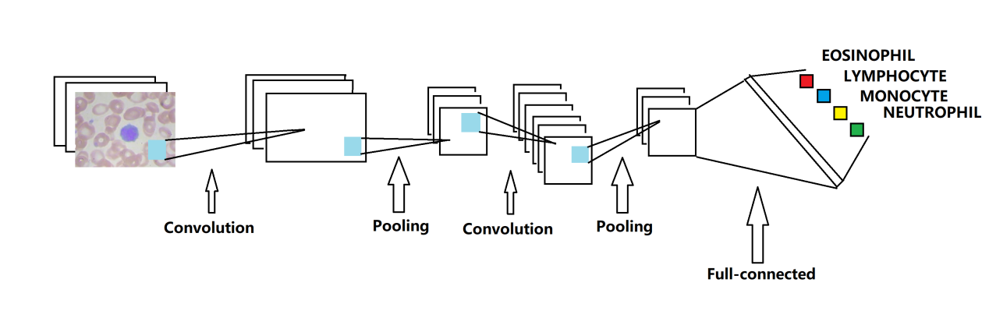
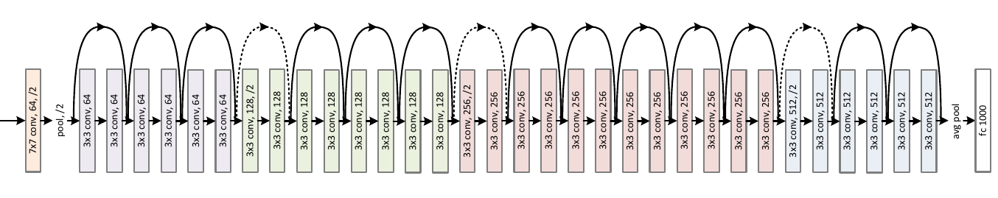
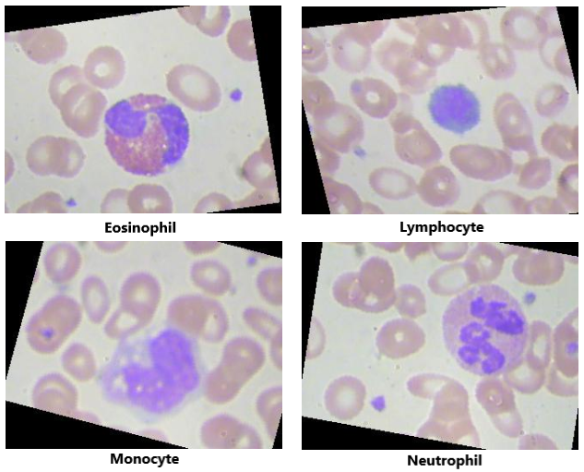
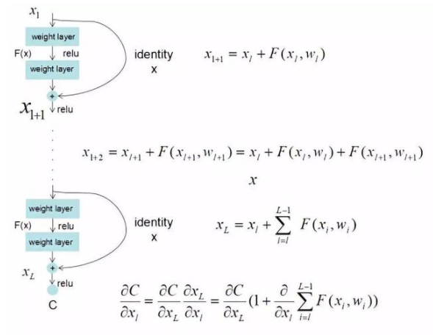
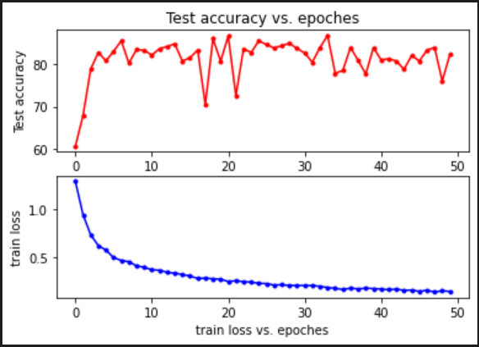
Chenxu Li, Haotian Wang, Zhihan Xiao, Shuyi Jin,
Teoh Teik Toe
THE UTILIZATION OF RESNET MODEL IN WHITE BLOOD
CELL CLASSIFICATION
Structure of CNN Model
ABSTRACT
With the rapid development and innovation in the field of computer science, artificial intelligence and machine learning have become more and more common in the daily life. In medical field, these technologies are used to support image processing and classification, like helping with blood test. Neutral networks will be chosen as the method. A classification system is founded on ResNet-50 model, which takes CNN as the main structure. The system extracts important features of images and analyzes images through layers. A trained model will be built using a dataset and then it can classify other strange samples.
Structure of
ResNet-50 Model
White Blood Cell Samples
Equations
Model
Evaluation

